Slide 1

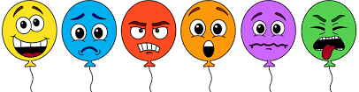
Have you ever heard of a wellbeing mentor?
What do we do?
How can we help?
Who are we?
Let's explain…

Slide 2



Let’s get to the big question what is a wellbeing mentor?
‘A wellbeing Mentor is a child who can act as a helping hand, a listener and someone who can support another child with making positive changes.’
Anna Freud Centre
What does a wellbeing mentor do?
‘The job of a wellbeing mentor is to provide support, encouragement, and information to the children they are supporting.’
Anna Freud Centre

Slide 3
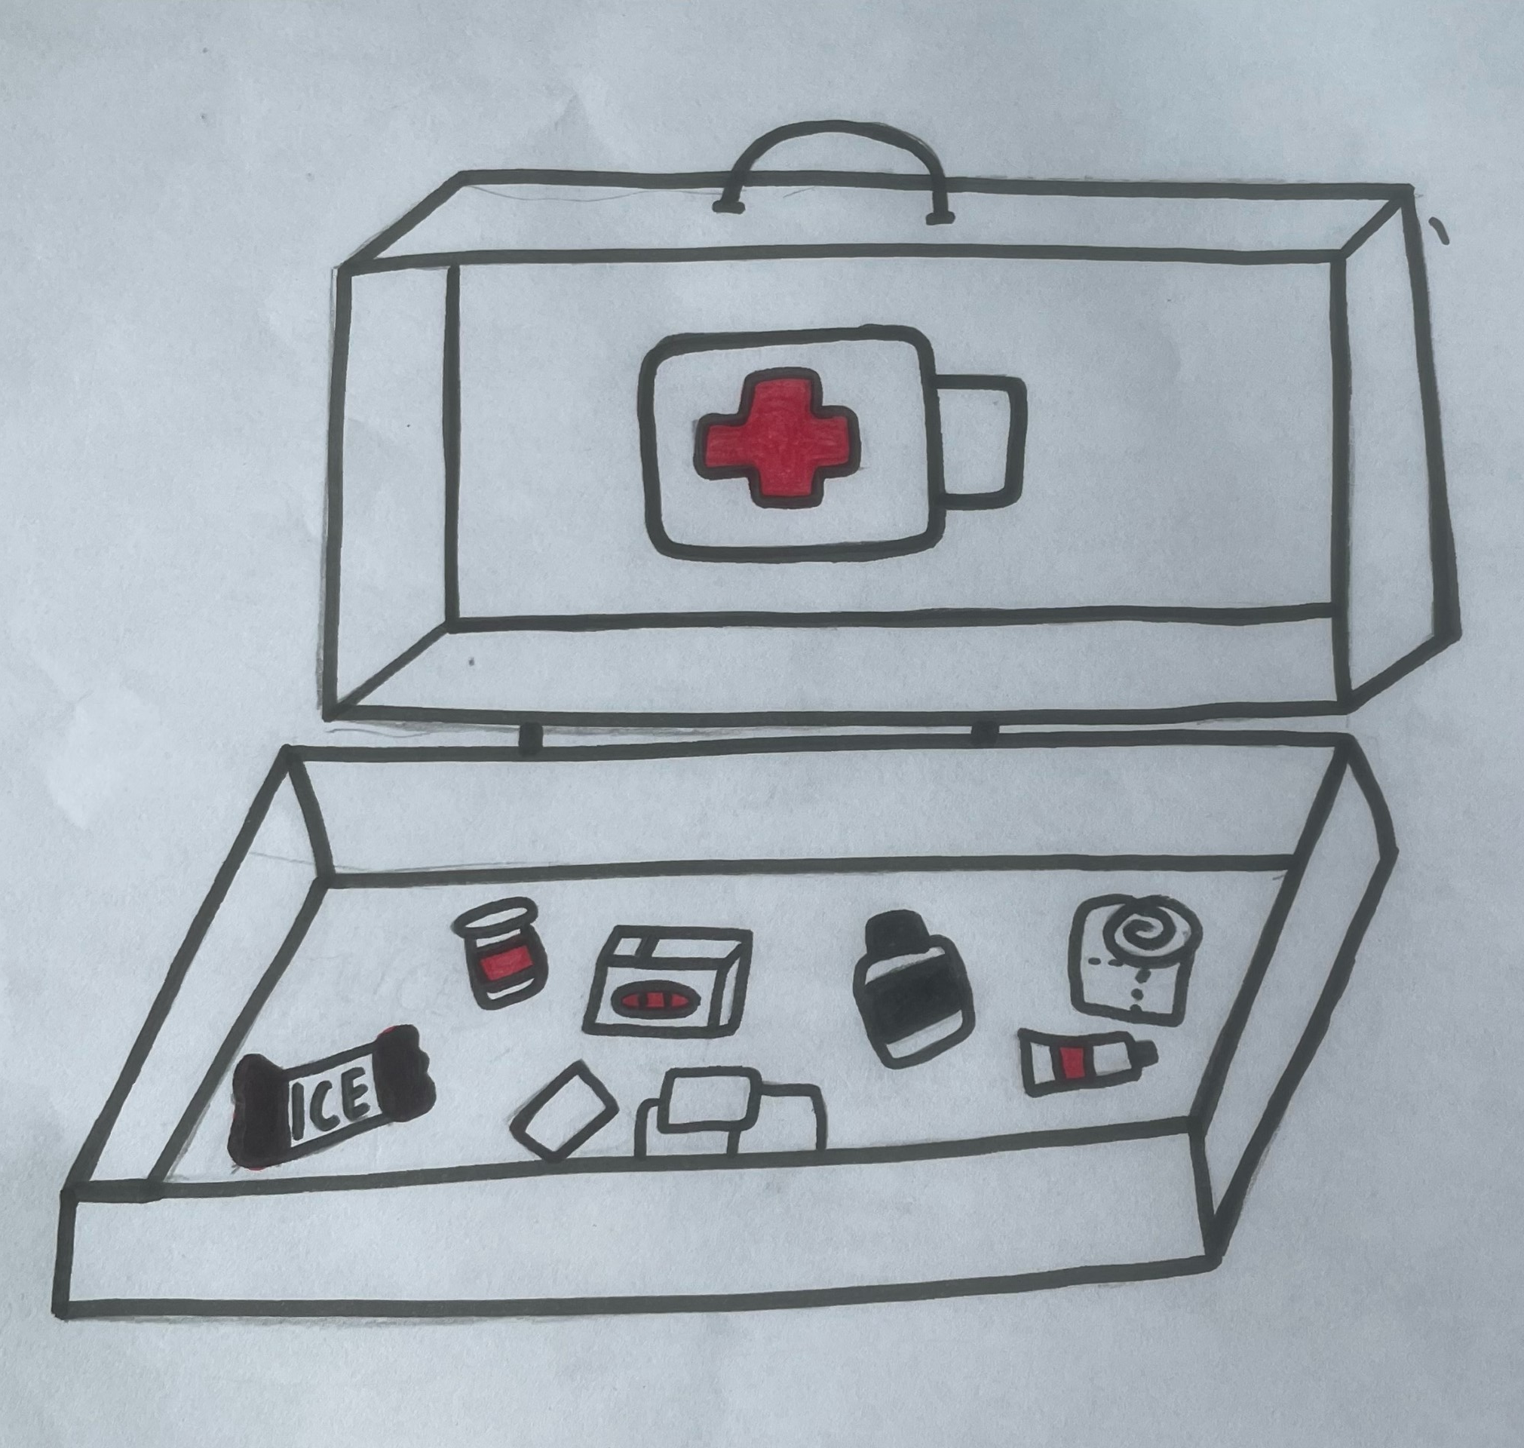
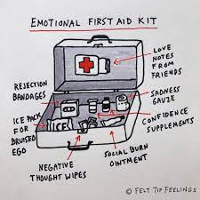
This is an Emotional first aid kit for the Wellbeing mentors to use when someone is feeling the physical signs of emotions or having negative thoughts and feelings.
Let’s see what is inside …
Emotional First Aid Kit
Talk time tissues
Positive plasters
Rejection bandages
Comforting cloths
Sadness swabs
Negative thought wipes
Embarrassment Ice pack

Slide 4
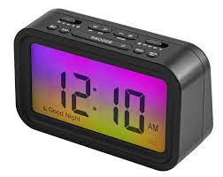
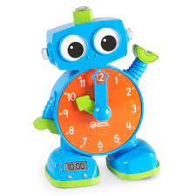
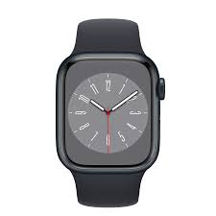
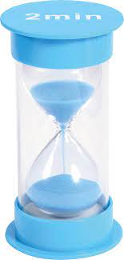
Time
A wellbeing mentor will always find time to listen to you if you feel lonely, overwhelmed, disappointed or if you feel worried about something. We can take you somewhere quieter to talk, practice some relaxation skills or just sit with you and keep you company.

Slide 5
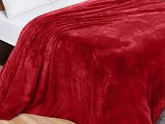
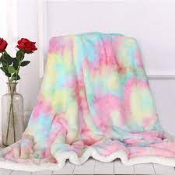
Blankets
Just like these blankets that feel soft and fuzzy, wellbeing mentors are full of kind and caring things to say to you.
If you’re feeling a bit upset or feel like you can not change a situation on your own, we can remind you that the emotion you are feeling will pass and go away.
Come to see us at break or lunchtime and we can help to cheer you up!

Slide 6
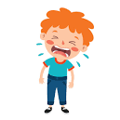
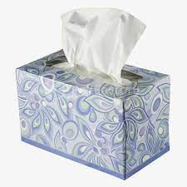
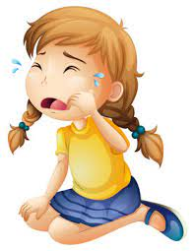
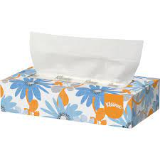
Tissues
A wellbeing mentor can help you wipe away your tears when you feel sad. Wellbeing mentors will remind you that it's okay to let out your tears, a good cry can make you feel better.
It is better to express and name your feelings rather than keep them bottled up inside you.

Slide 7
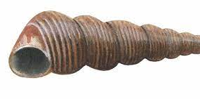
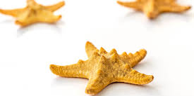
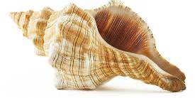
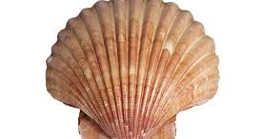
A shell
Just like shells we are all different, we look different on the outside and our brains work differently on the inside.
We can teach you some breathing techniques that will help you feel calm and grounded.
Wellbeing mentors will help you to notice all your fabulous ideas, thoughts and strengths to remind you of how special you are.

Slide 8
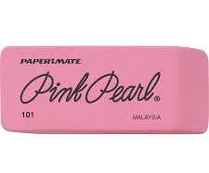

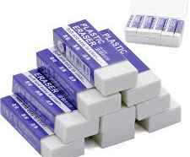
Rubber
Everyone makes mistakes when they are learning things and the mistakes we make, can help your brain to do new things.
When we make a mistake, we can feel disappointed or embarrassed and sometimes these feelings can make our bodies angry or shy. When we feel like this it can be hard for us to try again.
Just like a rubber, a wellbeing mentor can help rub out the old negative feelings and encourage you to be brave and try something again even if you feel nervous.

Slide 9

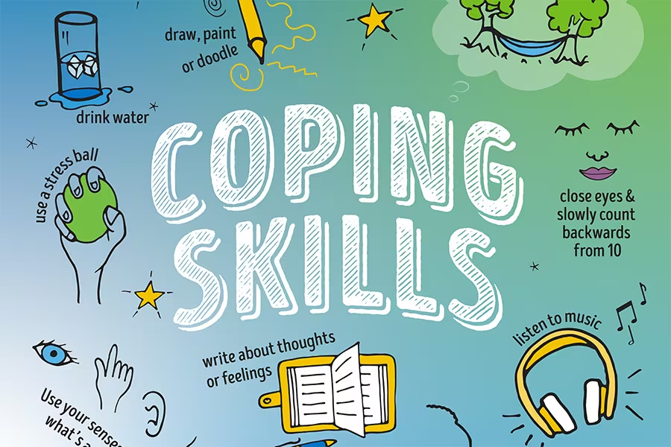
Pool Noodles
Wellbeing mentors are there to talk to us and help save you from scary, sad or stressful situations. Wellbeing mentors will help you stay afloat throughout the school year by giving you support, guidance and kindness. We can teach you different skills that will help you to control your body signs and emotions.

Slide 10
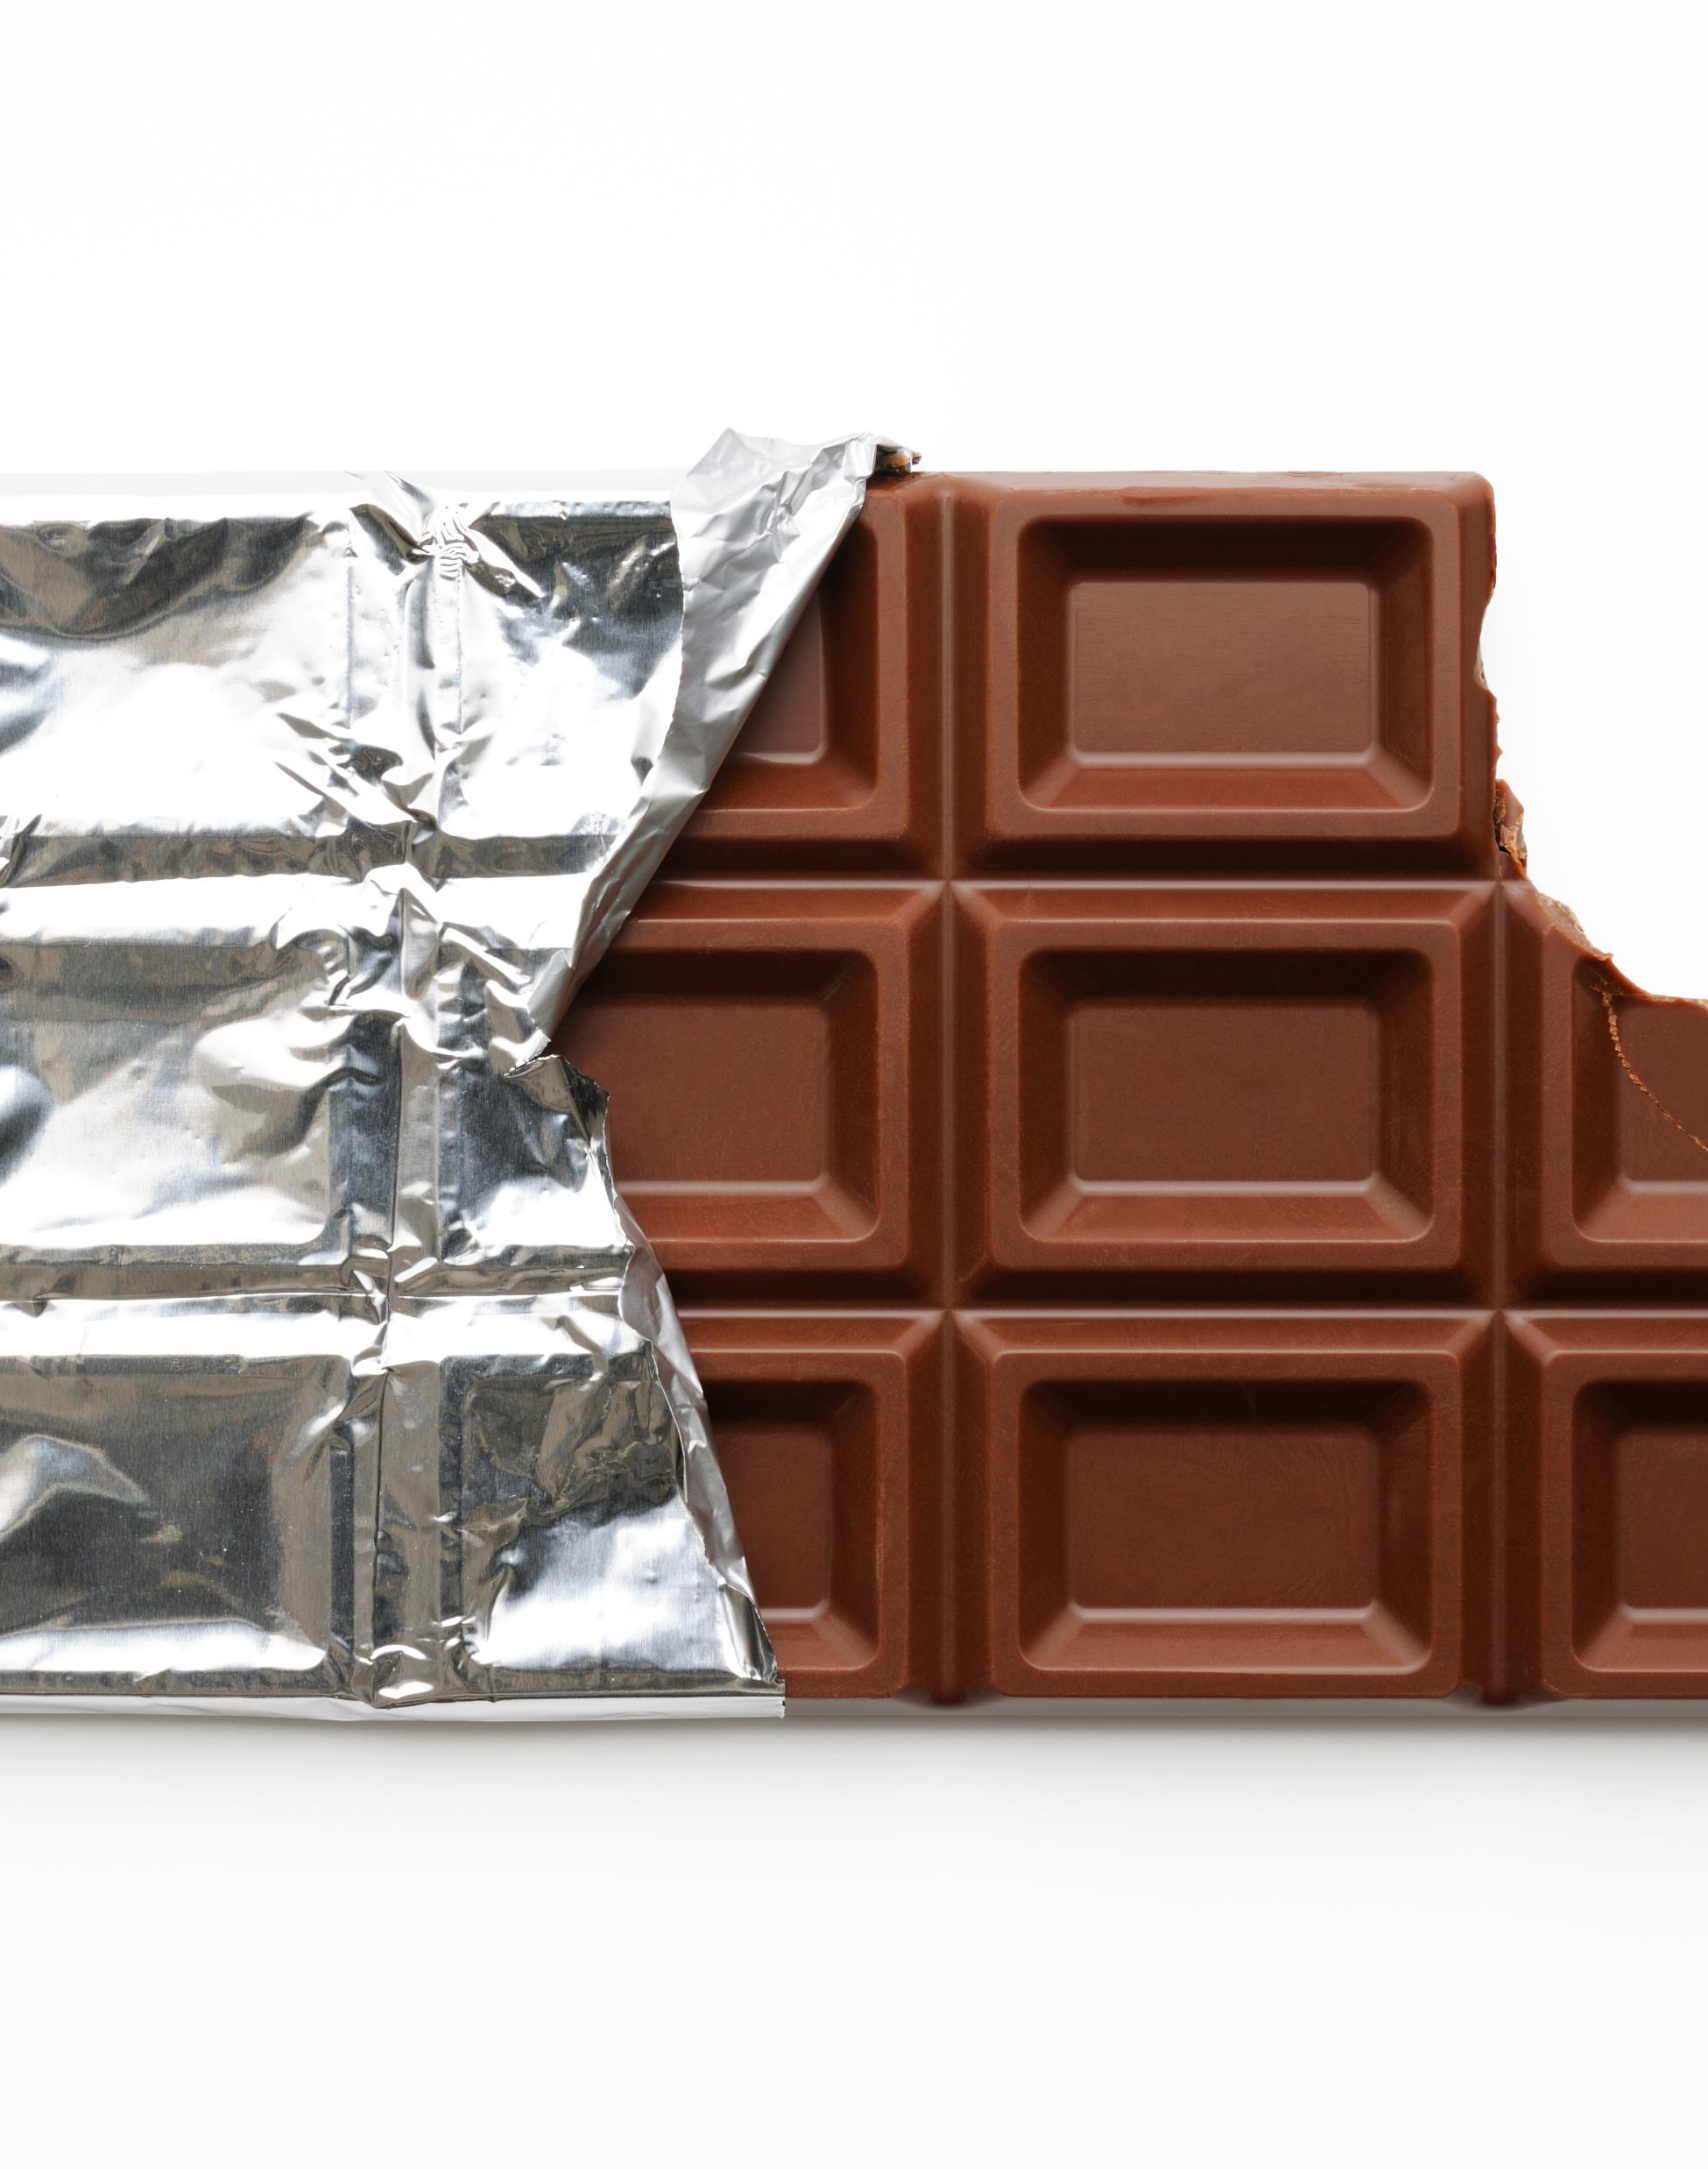
Chocolate bar
Wellbeing mentors are sweet like chocolate bars, we will make you feel safe and confident. We will spot your amazing abilities and compliment you constantly.
Just like a sugar rush, we will boost your self-esteem and help raise your energy levels if you are feeling low.

Slide 11
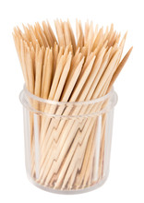

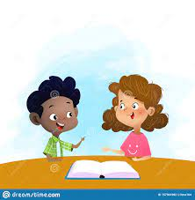
Toothpick
Wellbeing mentors can unpick your worries and help you decide what is fact or opinion. All of us feel worried or overloaded from time to time and a wellbeing mentor will help you find a solution that makes you feel happier and less stressed. Then you will have better control over your impulses and actions.

Slide 12
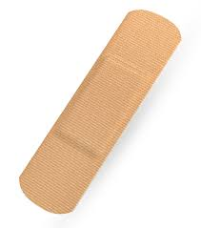

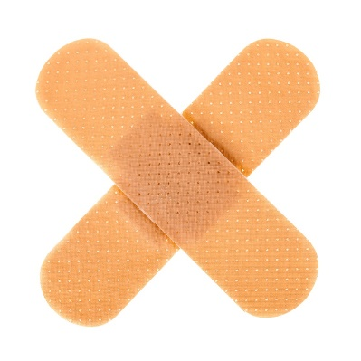
Plaster
A well-being mentor can help you to heal your invisible wounds that are deep inside of you.
There are different types of wounds, ones that you can see such as a grazed knee or a cut finger and ones that hurt us deep inside our heart.
Sometimes we can feel the pain all day long and because the pain is hidden deep inside us, nobody notices.
Wellbeing mentors will help you find a safe space to go to and a trusted adult to talk to about the pain in your heart.

Slide 13
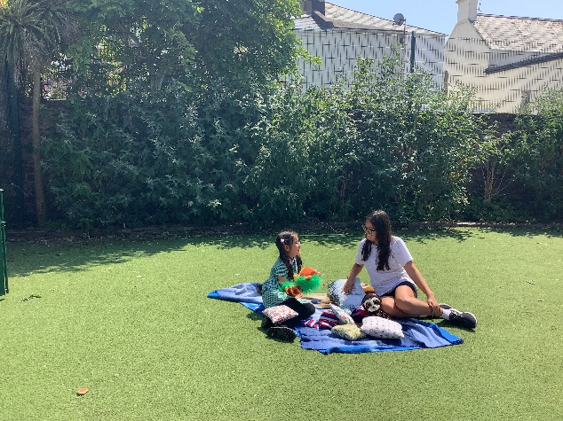
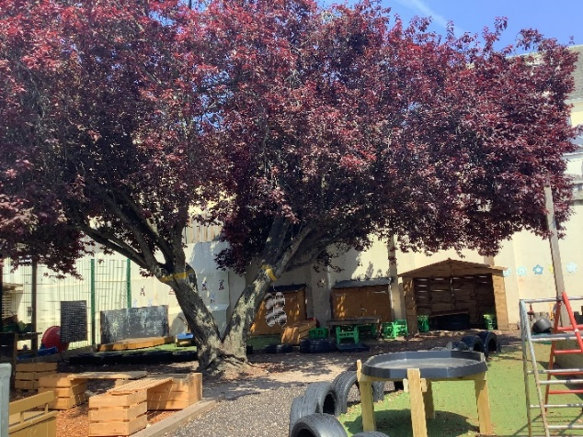
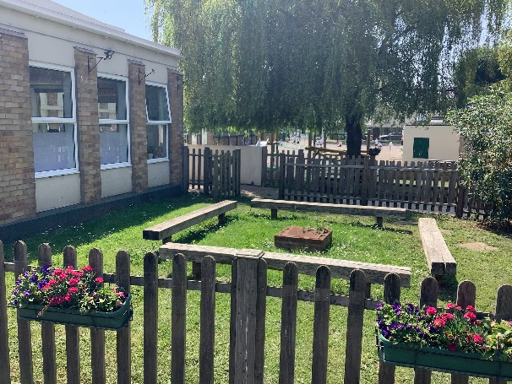
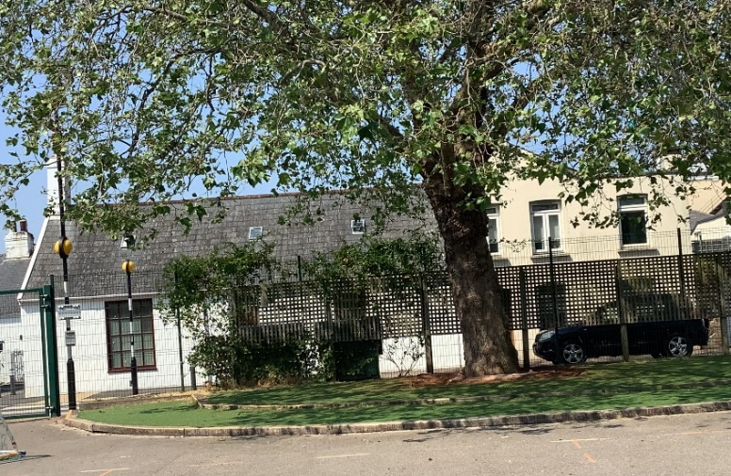
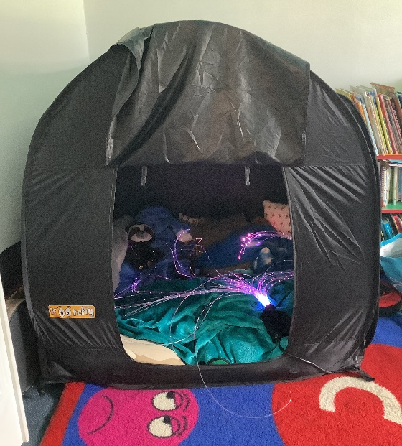
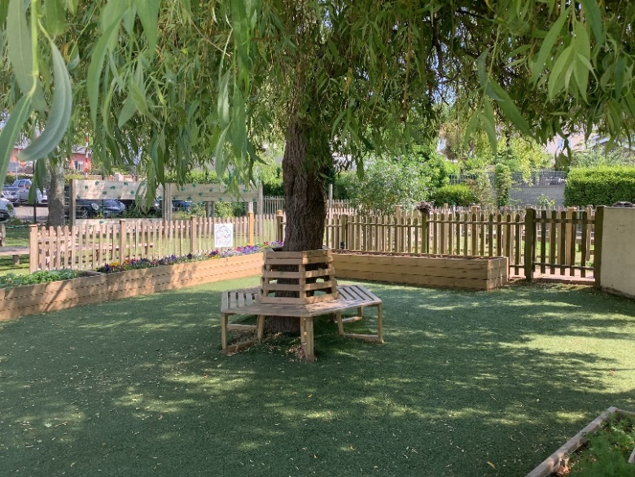
These are some of the safe spaces in the school where you can find the wellbeing mentors and have a chat.

Slide 14
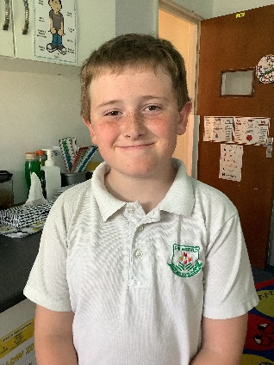
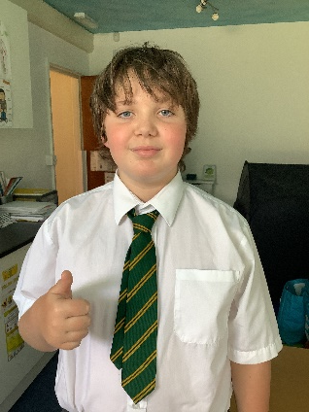
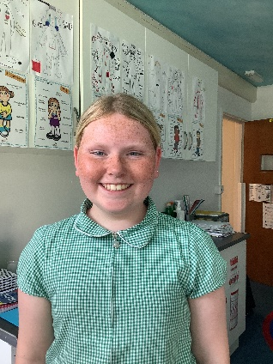
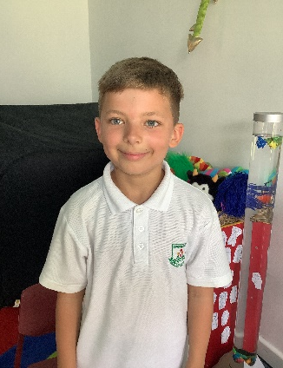
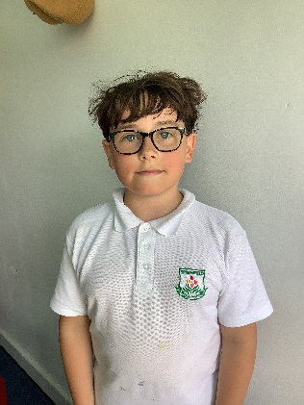
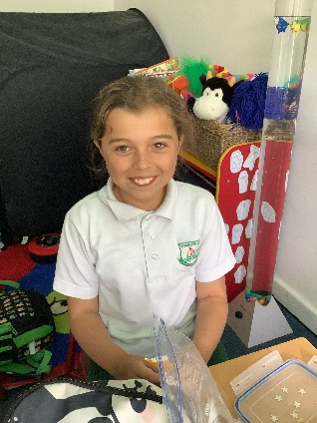
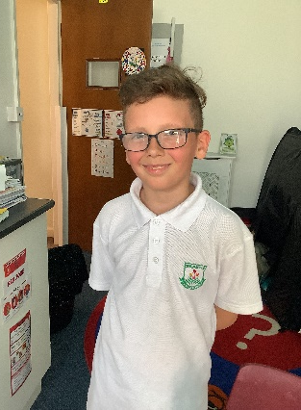
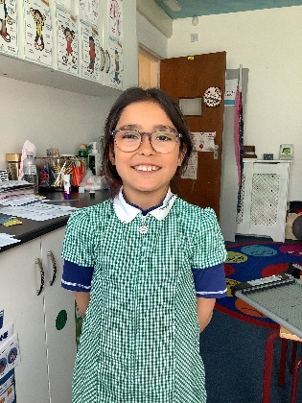
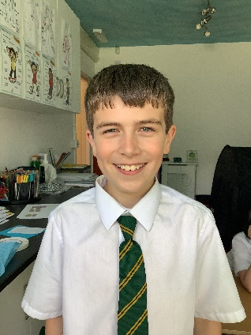
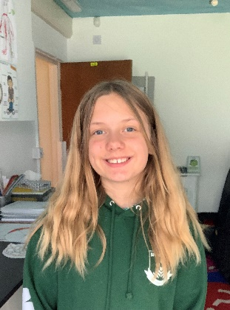
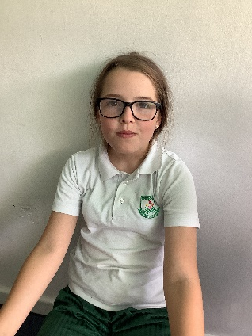
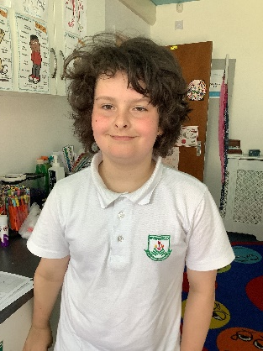
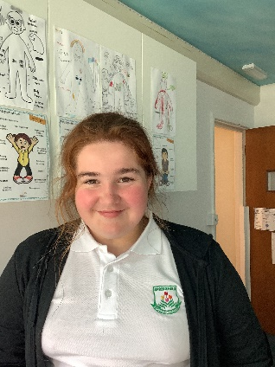
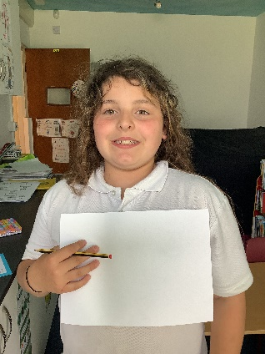
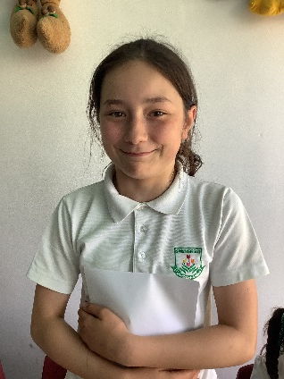
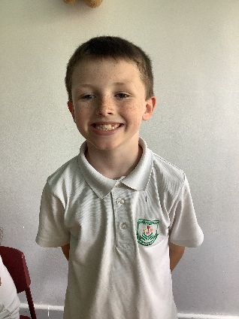
Aren’t they amazing! :D
Meet the wellbeing mentors

